Slide 1
Fracture
Diagnostic and Procedural Coding
CPT & ICD-10-CM

Slide 2
Agenda
What is Fracture
Types of Fracture
ICD -10-CM coding of Fractures
Diagnostic options
Treatment options
CPT coding of Fracture treatment
Coding Nuances in ER/Urgent care and Orthopedic care

Slide 3
Fracture
A fracture is a break, usually in a bone. If the broken bone punctures the skin, it is called an open or compound fracture.
Fractures commonly happen because of car accidents, falls, or sports injuries.
Other causes are low bone density and osteoporosis, which cause weakening of the bones

Slide 4
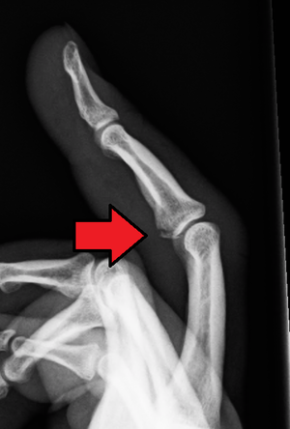
Avulsion fracture
a muscle or ligament pulls on the bone, fracturing it.

Slide 5
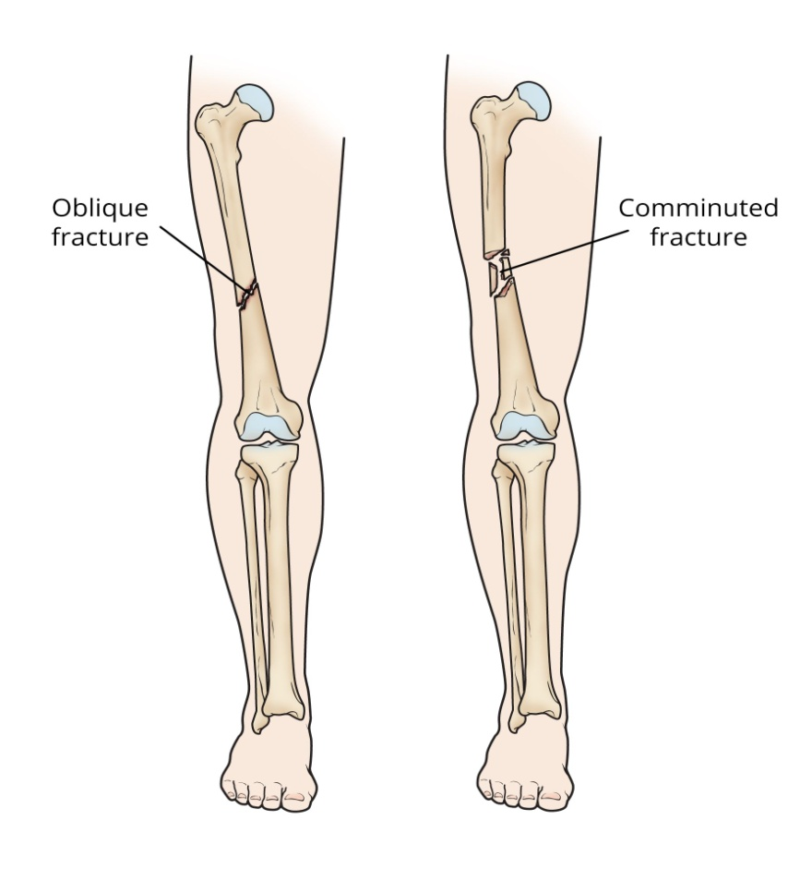
Comminuted fracture
the bone is shattered into many pieces

Slide 6
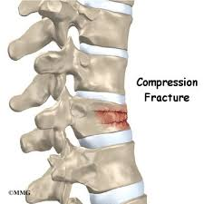
Compression (crush) fracture
Generally occurs in the spongy bone in the spine. For example, the front portion of a vertebra in the spine may collapse due to osteoporosis.

Slide 7
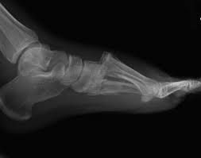
Fracture dislocation
a joint becomes dislocated, and one of the bones of the joint has a fracture.

Slide 8
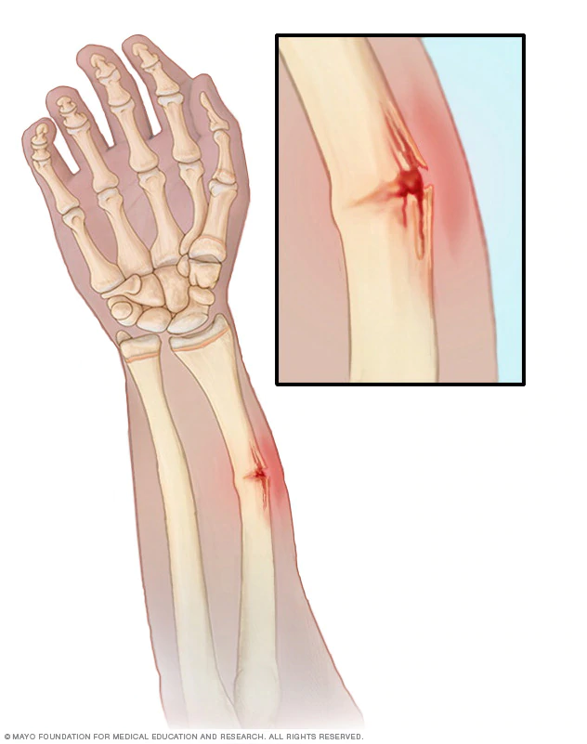
Greenstick fracture
the bone partly fractures on one side, but does not break completely because the rest of the bone can bend. This is more common among children, whose bones are softer and more elastic.

Slide 9
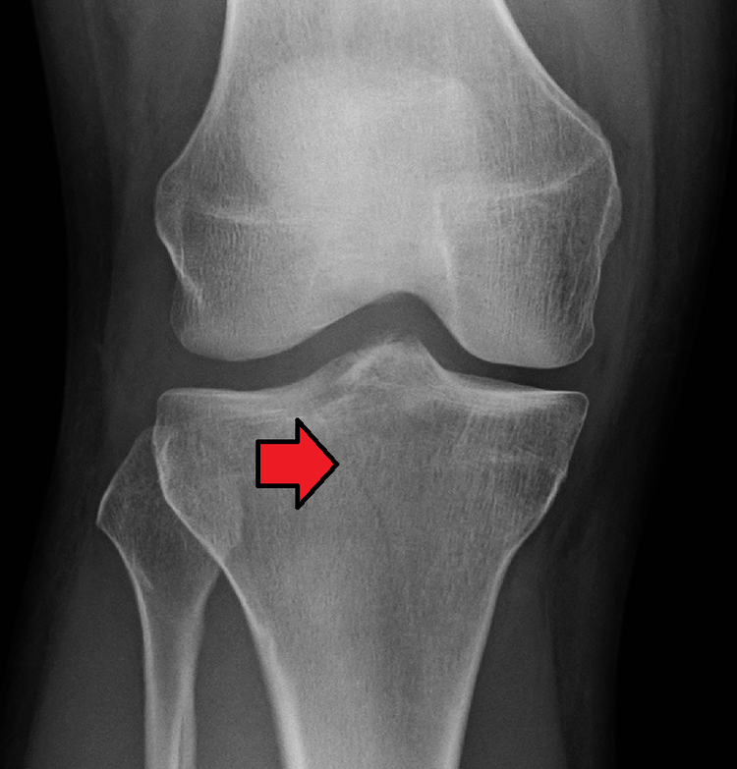
Hairline fracture
a partial fracture of the bone. Sometimes this type of fracture is harder to detect with routine x-rays.

Slide 10
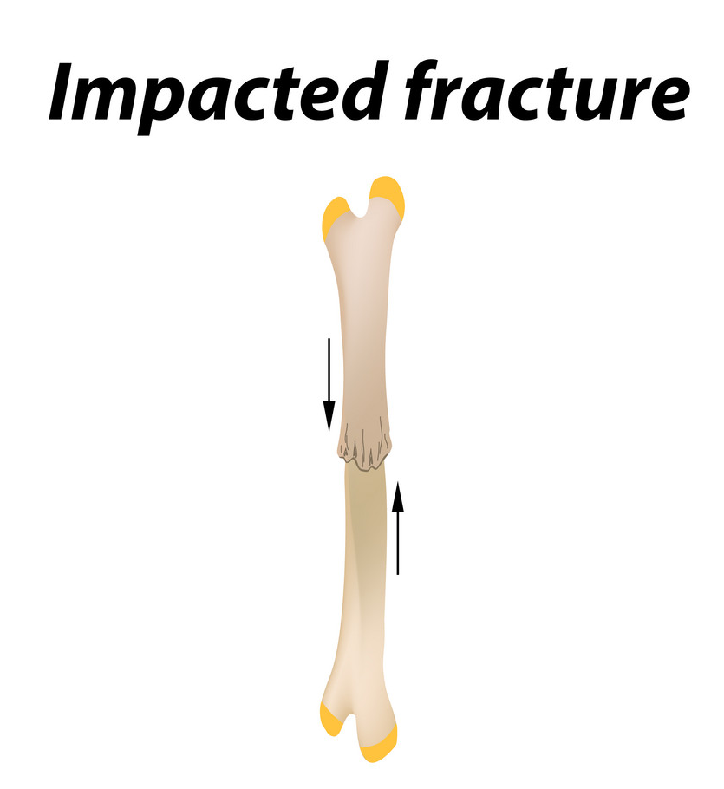
Impacted fracture
when the bone is fractured, one fragment of bone goes into another

Slide 11
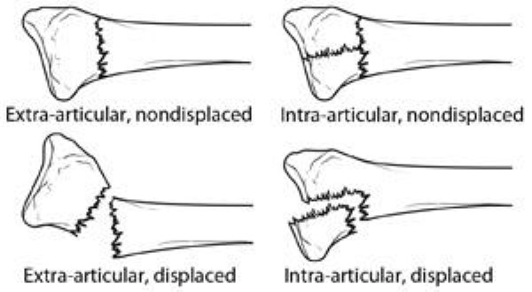
Intraarticular fracture
where the break extends into the surface of a joint

Slide 12
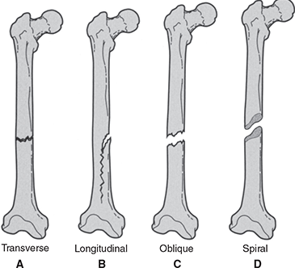
Other Fractures
Longitudinal fracture - the break is along the length of the bone.
Oblique fracture - a fracture that is diagonal to a bone's long axis.
Spiral fracture - a fracture where at least one part of the bone has been twisted.
Transverse fracture - a straight break right across a bone.

Slide 13
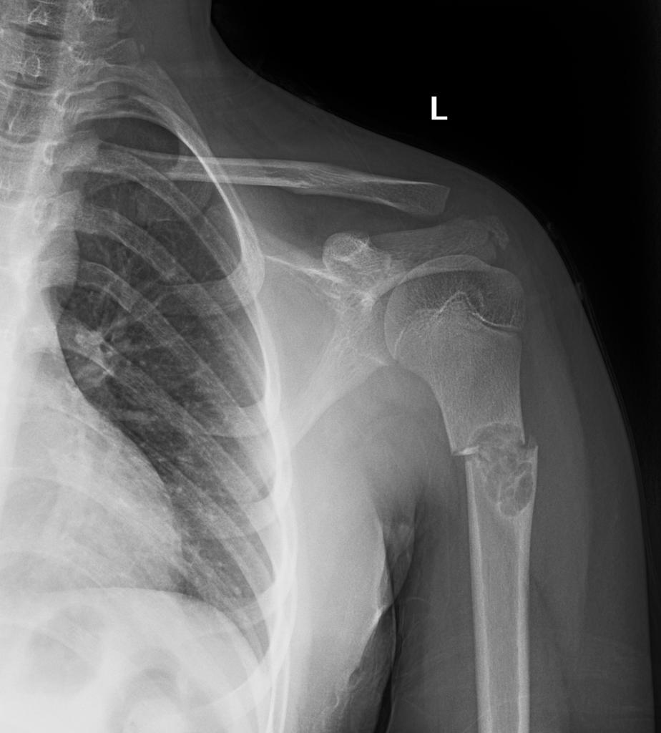
Pathological fracture
When an underlying disease or condition has already weakened the bone, resulting in a fracture (bone fracture caused by an underlying disease/condition that weakened the bone).

Slide 14
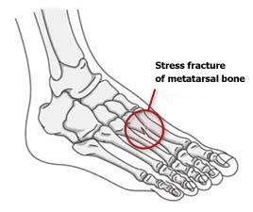
Stress fracture
More common among athletes. A bone breaks because of repeated stresses and strains.

Slide 15
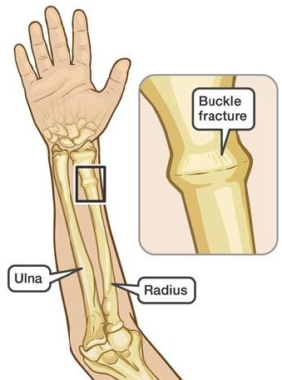
Torus (buckle) fracture
Bone deforms but does not crack. More common in children. It is painful but stable.

Slide 16
Diagnosis
A doctor will carry out a physical examination, identify signs and symptoms, and make a diagnosis.
Doctors will often order an X-ray. In some cases, an MRI or CT scan may also be ordered.

Slide 17
Treatment
Bone healing is a natural processTrusted Source which, in most cases, will occur automatically. Fracture treatment is usually aimed at making sure there is the best possible function of the injured part after healing.
Treatment also focuses on providing the injured bone with the best circumstances for optimum healing (immobilization).
For the natural healing process to begin, the ends of the broken bone need to be lined up - this is known as reducing the fracture.
The patient is usually asleep under a general anesthetic when fracture reduction is done. Fracture reduction may be done by manipulation, closed reduction (pulling the bone fragments), or surgery.

Slide 18
Immobilization
Plaster casts or plastic functional braces - these hold the bone in position until it has healed.
Metal plates and screws - current procedures may use minimally invasive techniques.
Intra-medullary nails - internal metal rods are placed down the center of long bones. Flexible wires may be used in children.
External fixators - these may be made of metal or carbon fiber; they have steel pins that go into the bone directly through the skin. They are a type of scaffolding outside the body.

Slide 19
Immobilization
Usually, the fractured bone area is immobilized for 2-8 weeks. The duration depends on which bone is affected and whether there are any complications, such as a blood supply problem or an infection

